Slide 1
The Smarter Balanced Assessment Consortium
Finding Resources in the Digital Library
Notes:
Welcome to the Finding Resources in the Digital Library Tutorial. There are several ways to find resources in the Digital Library. You can mark your favorites for easier access later.

Slide 2
Topics
How do I find resources in the Digital Library? (slides 3 – 13)
How do I find the interactive modules? (slides 14 – 17)
How do I mark a resource as a favorite? (slides 18 – 25)
Notes:
Topics for Finding Resources in the Digital Library include:
How do I find resources in the Digital Library?
How do I find the interactive modules?
How do I mark a resource as a favorite?

Slide 3
Topics
How do I find resources in the Digital Library?
How do I find the interactive modules?
How do I mark a resource as a favorite?
Notes:
Let’s discuss the different ways to find resources in the Digital Library.

Slide 4
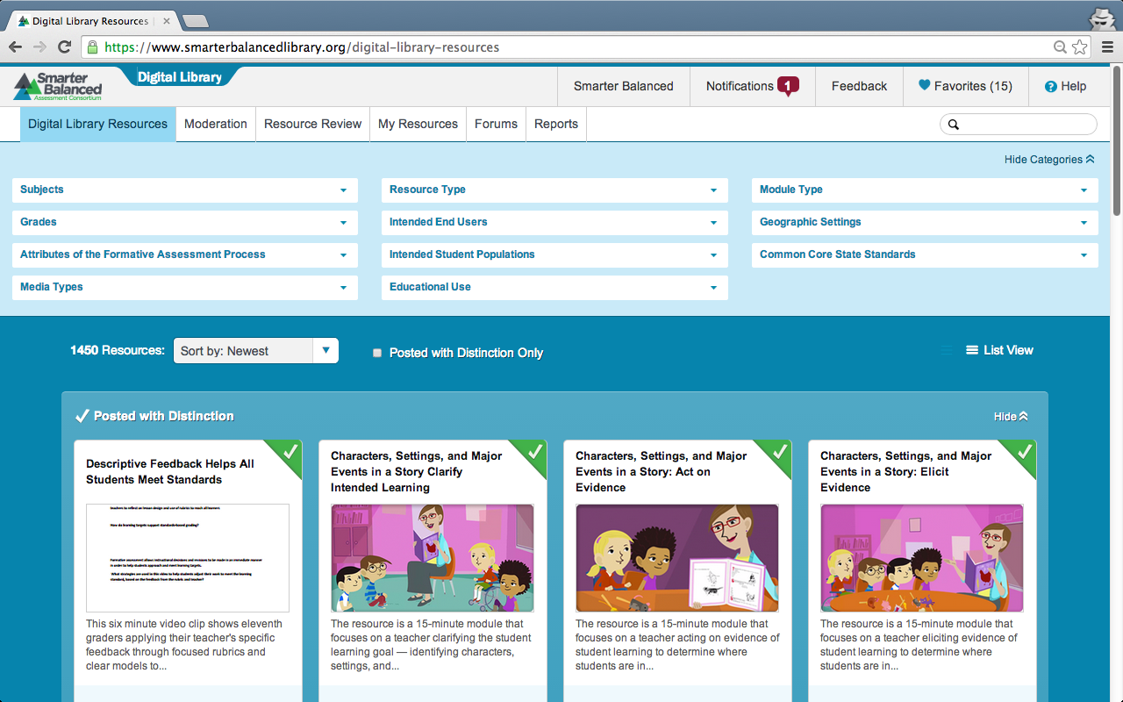
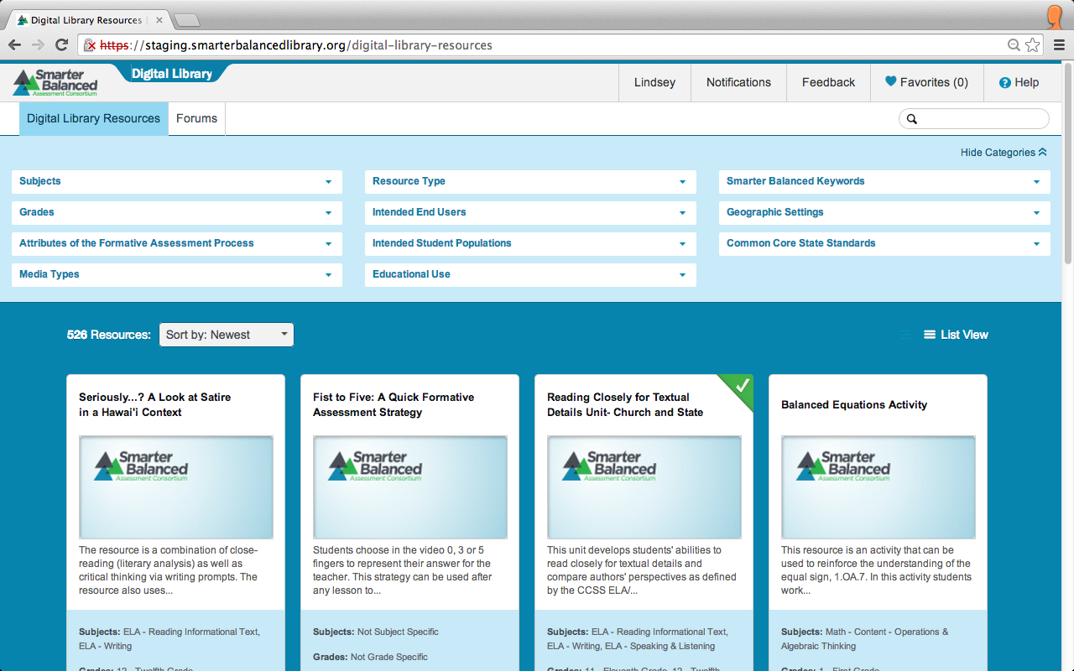
Digital Library Resources
Notes:
This is the Digital Library Resources page. It displays all the resources that have been posted to the Digital Library.

Slide 5
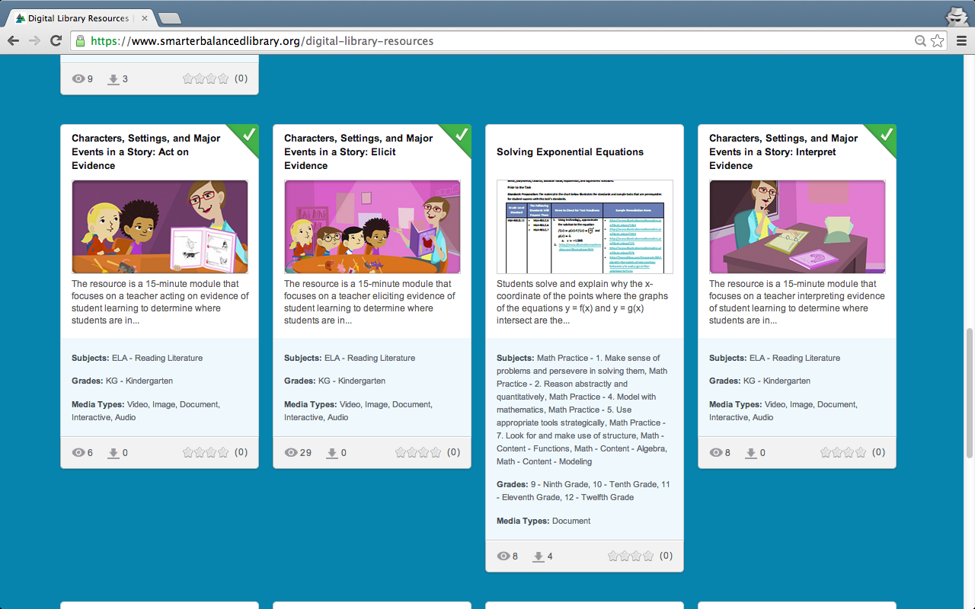
Resource Cards
Notes:
Resources are displayed as cards that include the following information:
Resource Title
Image of primary material
The first 140 characters of the resource summary
Selected tags
Number of views
Number of downloads
Star rating
A checkmark in the top right corner of a resource card indicates that a resource has been posted with distinction. This means that it received the highest recommendation from all three reviewers of the resource.

Slide 6
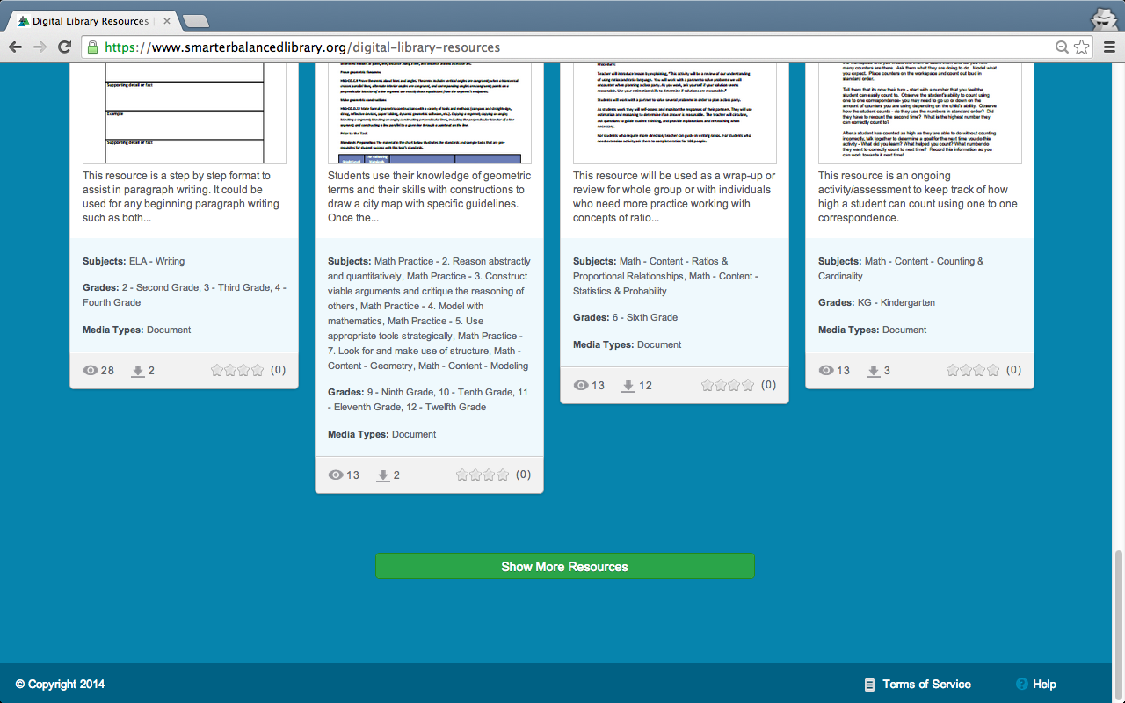
Show More Resources
Notes:
By default, 12 resource cards are displayed. To see more, scroll to the bottom of the page and click Show More Resources and the next 12 resource cards will be displayed.

Slide 7
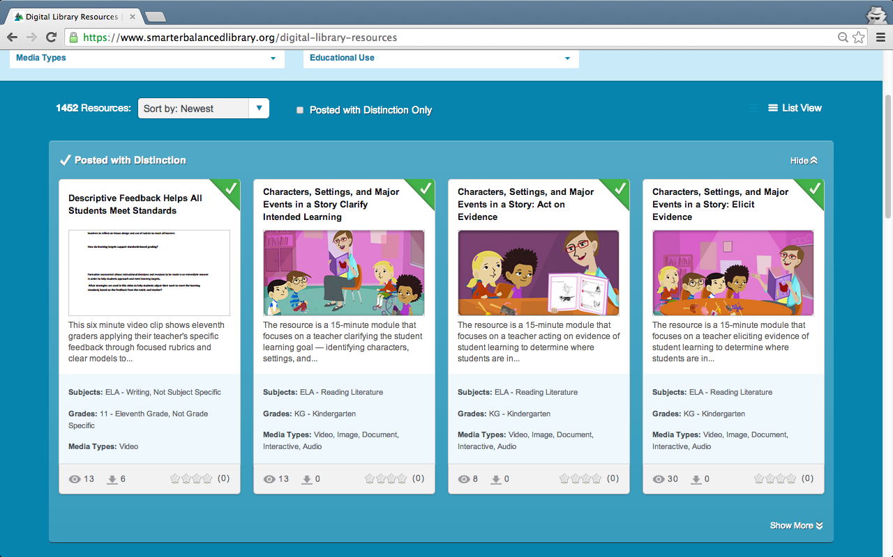
Posted with Distinction
Notes:
At the very top of the resources is a section displaying resources that have been posted with distinction.
You may choose to click Show More in the bottom right corner of this section to show more resources posted with distinction. Or you may choose to click Hide in the top right corner to hide this section and view all resources.
You may also check the box at the top of the section for Posted with Distinction Only to only display resources posted with distinction.

Slide 8
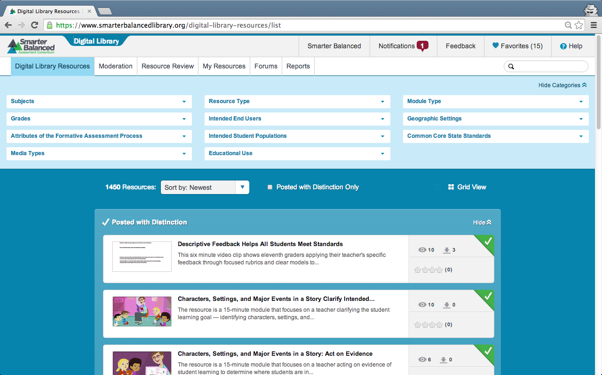
View Options
Notes:
There are two ways to view resources:
Grid View displays resources as cards. This is the default view, as seen in the previous slides.
List View displays resources in a list, shown here. List view provides a less detailed display than Grid View.
You can change the view option by choosing Grid View or List View on the right side of the window above the resource cards.
Click Grid View to return to Grid View.

Slide 9
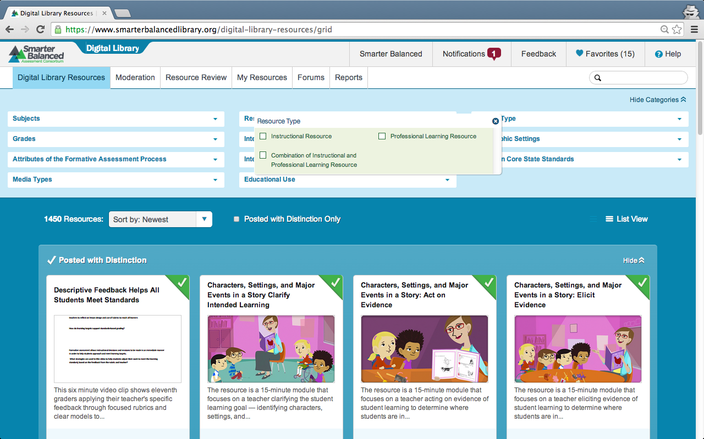
Filter Digital Library Resources
Notes:
There are three ways you can search for resources in the Digital Library.
First, you can filter using as many as 11 categories that are displayed above the resource cards. These include: Subject, Grade, Attribute of the Formative Assessment Process, Common Core State Standards, etc.
If you do not want to use the filters, you can hide the categories by clicking Hide Categories in the top right of the filter section.

Slide 10
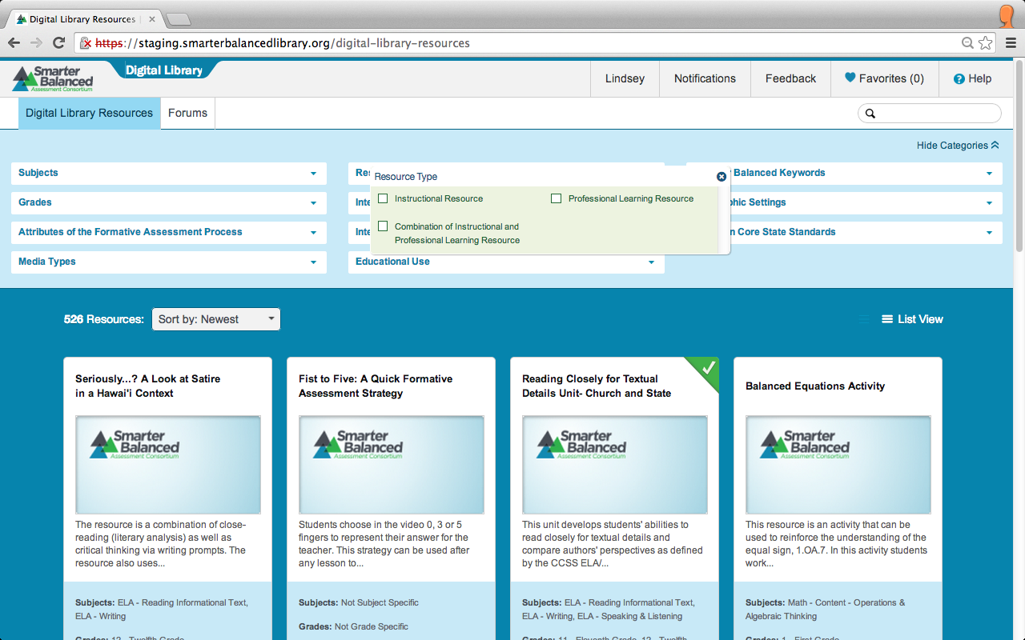
Filter Digital Library Resources
Notes:
When you click on a filter category, a separate drop-down menu appears. This example shows the drop-down box for Resource Type.
Check the boxes you want to customize your search.

Slide 11
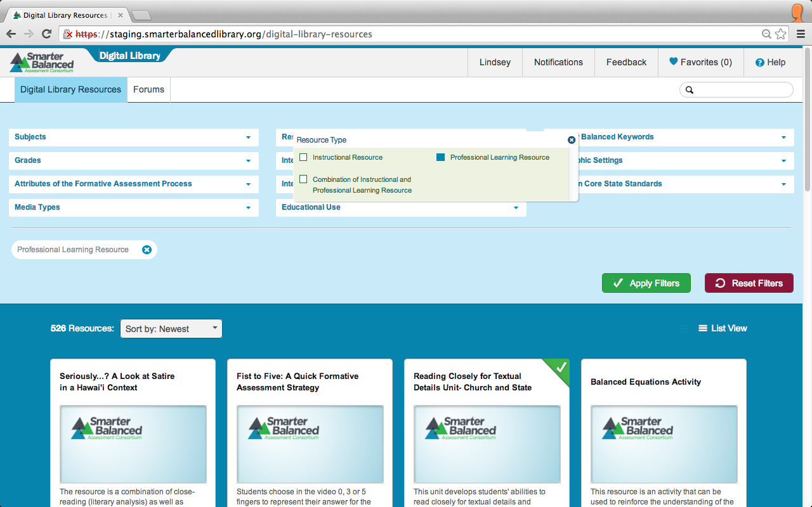
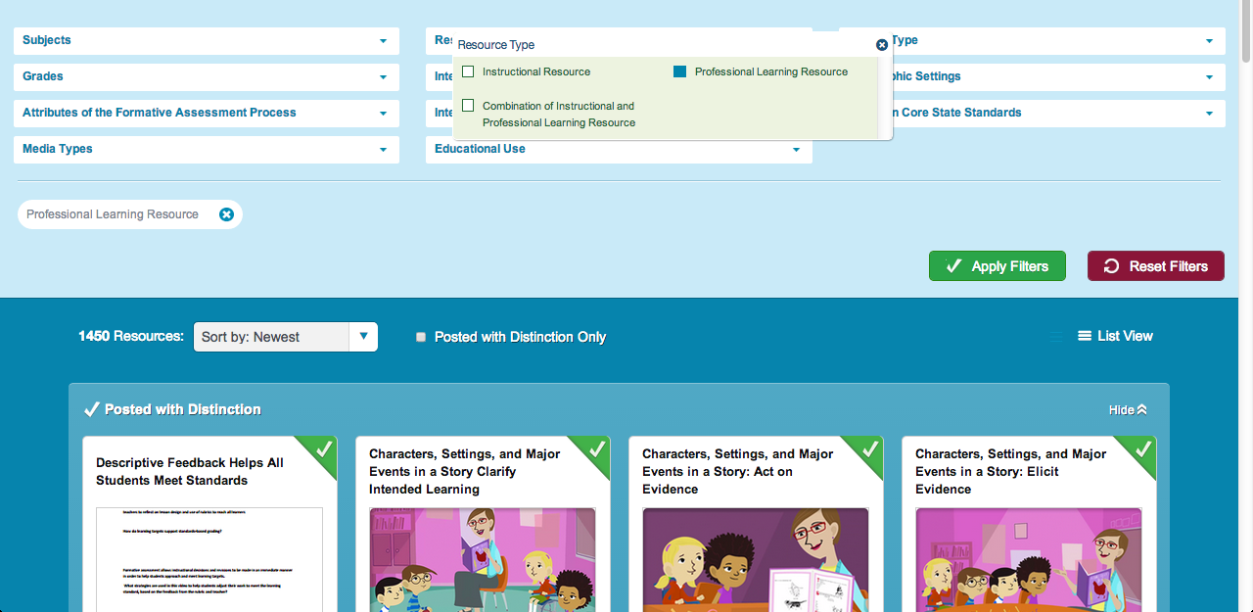
Filter Digital Library Resources
Notes:
Once you have selected your filters, they will appear below the filter options.
Click Apply Filters to begin your search.

Slide 12
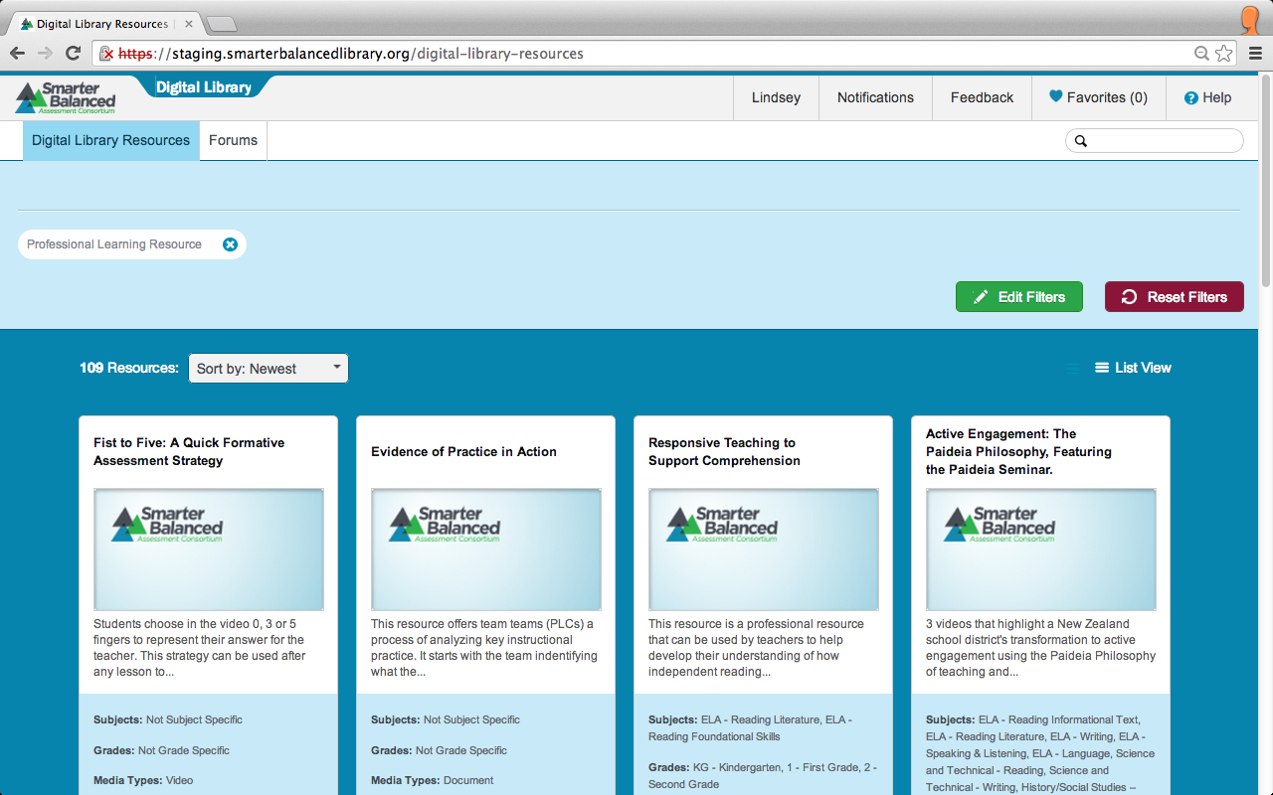
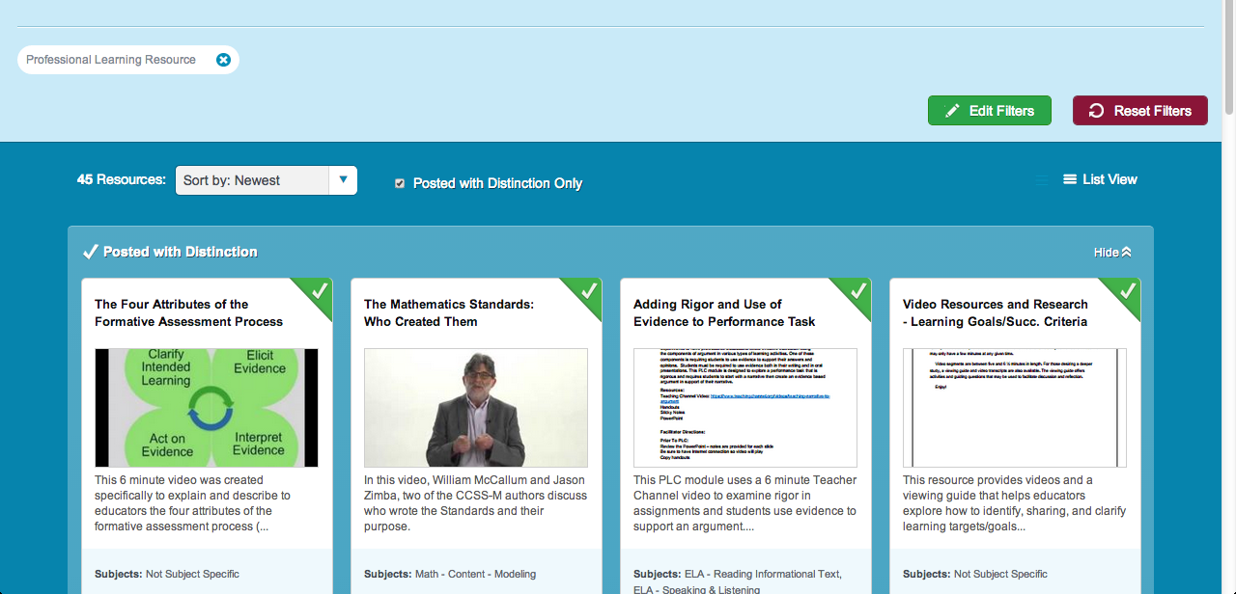
Filter Digital Library Resources
Notes:
After applying your selected filters, you may choose to edit those filters by clicking Edit Filters.
You can clear the filters by clicking Reset Filters.

Slide 13
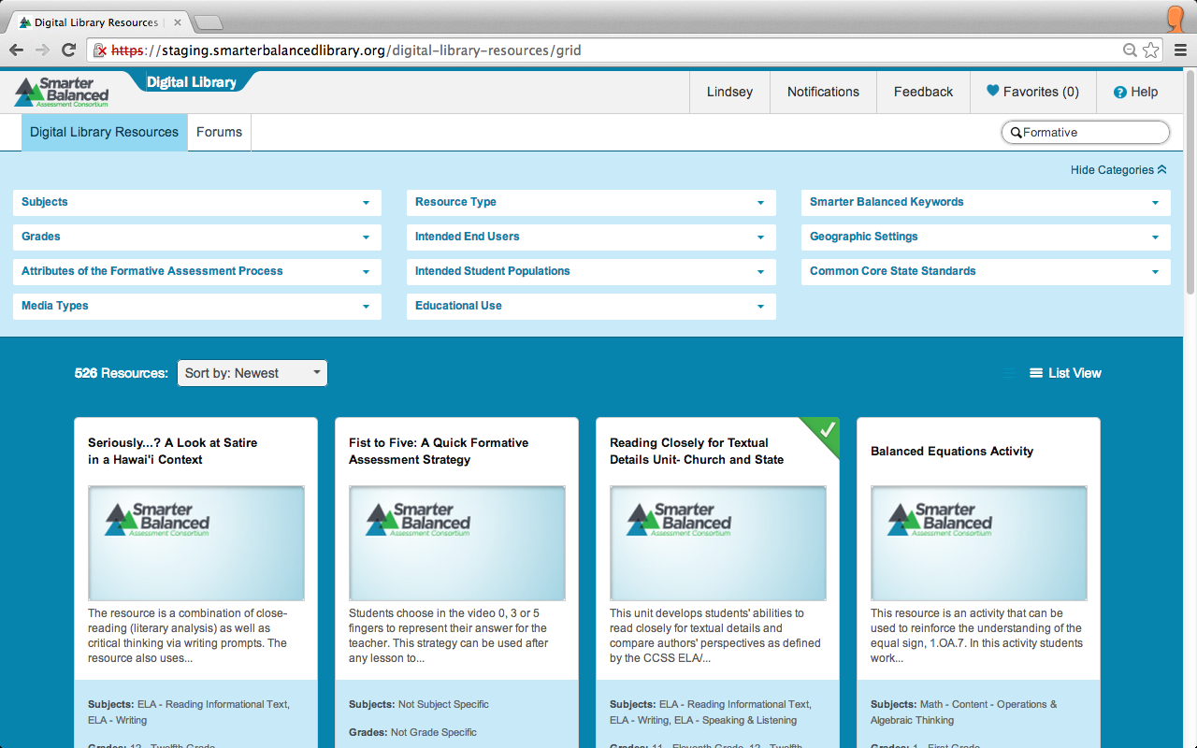

Search Digital Library Resources
Notes:
A second way to search for resources is to use the search bar in the upper right corner of the screen.
Type key words in the oval next to the magnifying glass.
Press the enter or return key on your computer to begin your search. Resources containing these words will be displayed.

Slide 14
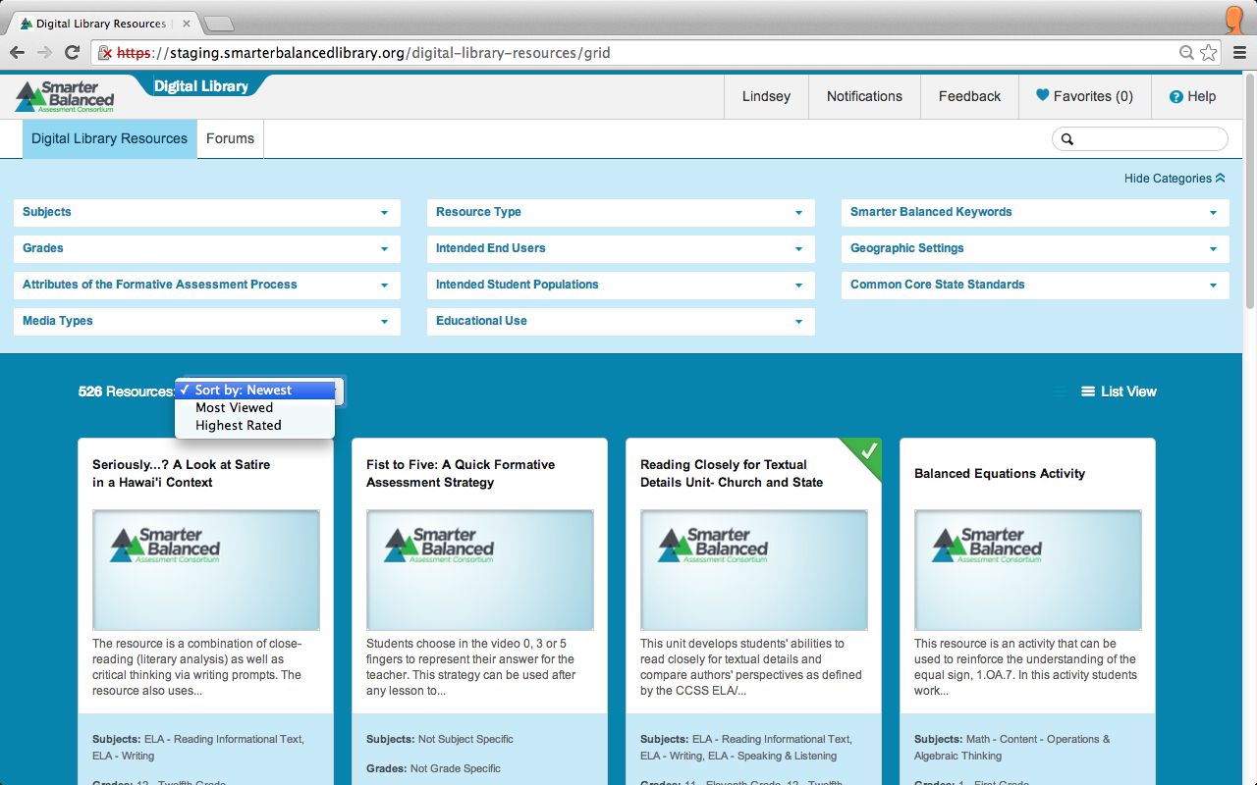
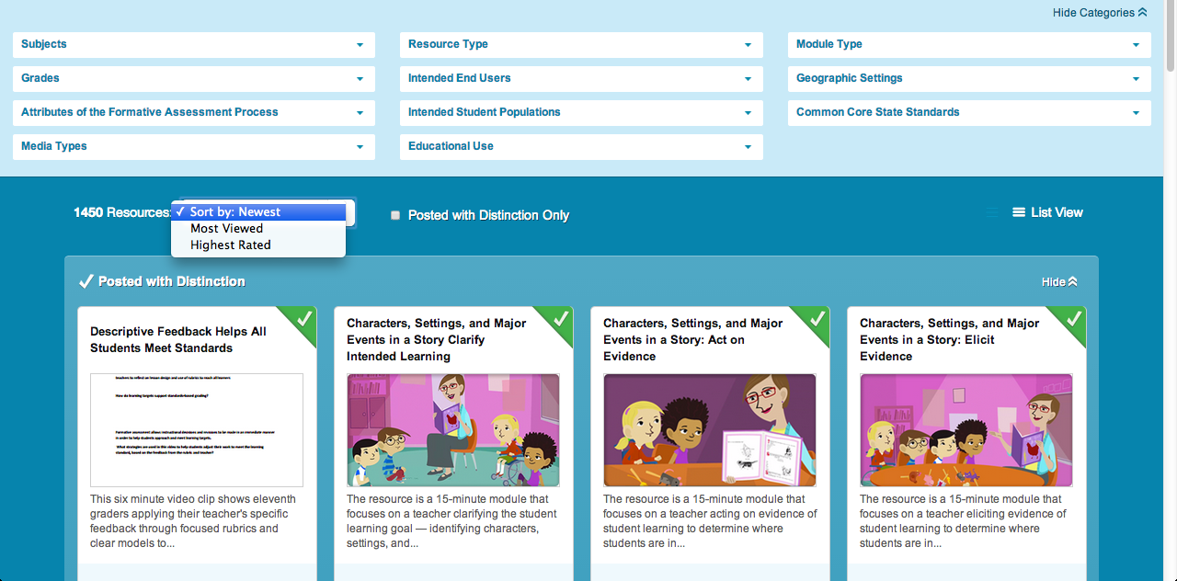
Sort Digital Library Resources
Notes:
The third way to search for resources is to use the Sort feature.
You can change the way resources are listed using the sort box on the left side of the screen under the filter categories. By default, resources are listed with the newest showing first.
When you click on Sort by: Newest, a drop-down menu appears that allows you to sort by Most Viewed or Highest Rated.

Slide 15
Topics
How do I find resources in the Digital Library?
How do I find the interactive modules?
How do I mark a resource as a favorite?
Notes:
Let’s review how to find the interactive modules.

Slide 16
Interactive Modules
Notes:
Interactive modules are of 4 types: Assessment Literacy, Instruction for English Language Arts, Instruction for Mathematics, and Score Reports. They provide opportunities for Digital Library users to learn more about a balanced assessment system and how to implement the intent of the Common Core State Standards using the Formative Assessment Process. All of them include interactive learning events, and most include an animated or live-action vignette. When the project is complete, there will be 102 modules – look for more of them to become available throughout the Preview Period.
To find these interactive modules, filter using the Module Type drop-down menu.

Slide 17
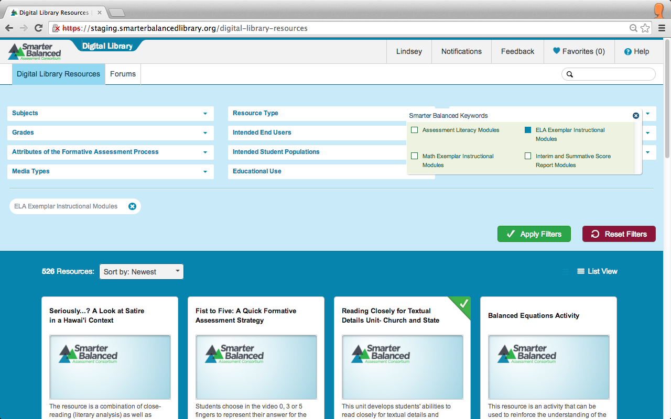

Interactive Modules
Notes:
Choose one of the four module types (not all will be available in the initial Preview Period):
Assessment Literacy Modules
ELA Exemplar Instructional Modules
Math Exemplar Instructional Modules
Interim and Summative Score Report Modules
Select the module type you are interested in by checking the box. Click Apply Filters.

Slide 18
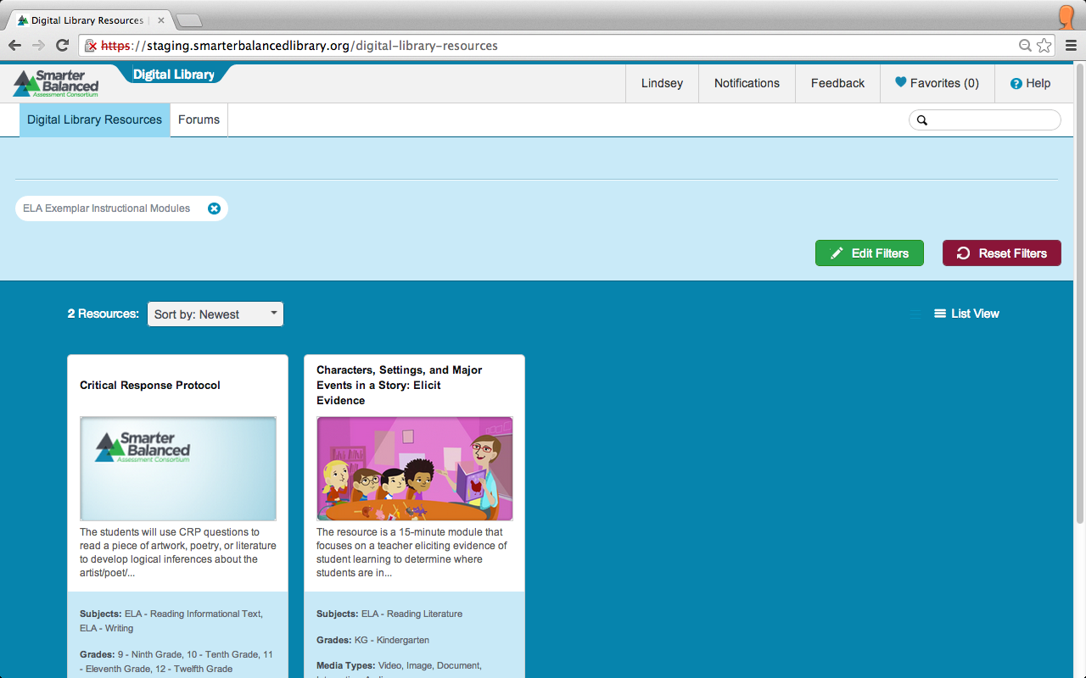
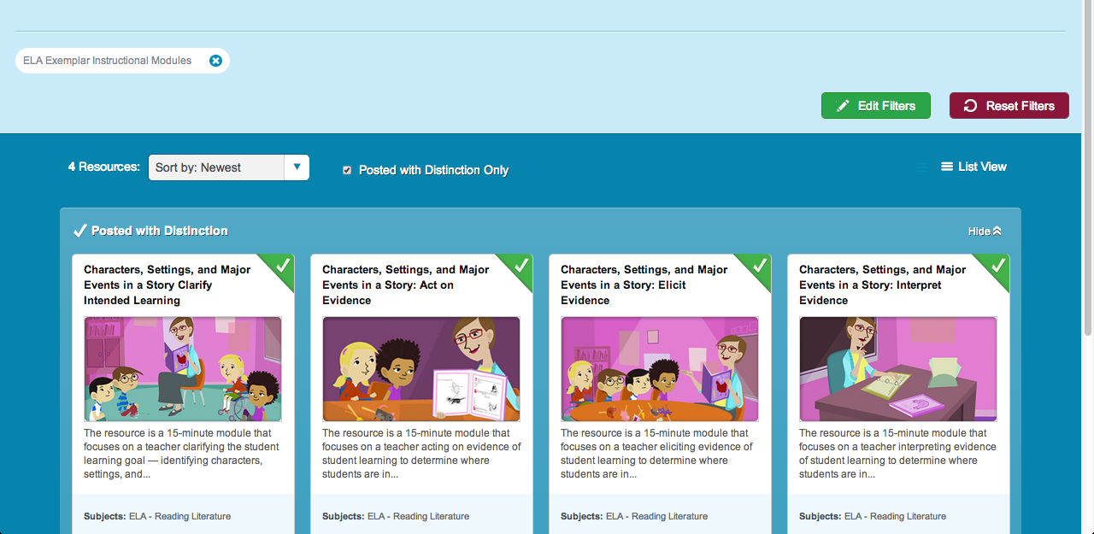
Interactive Modules
Notes:
All available modules for the type you chose will appear.
Click on the title of the module to access them.

Slide 19
Topics
How do I find resources in the Digital Library?
How do I find the interactive modules?
How do I mark a resource as a favorite?
Notes:
Now let’s explore how to mark a resource as a favorite.

Slide 20
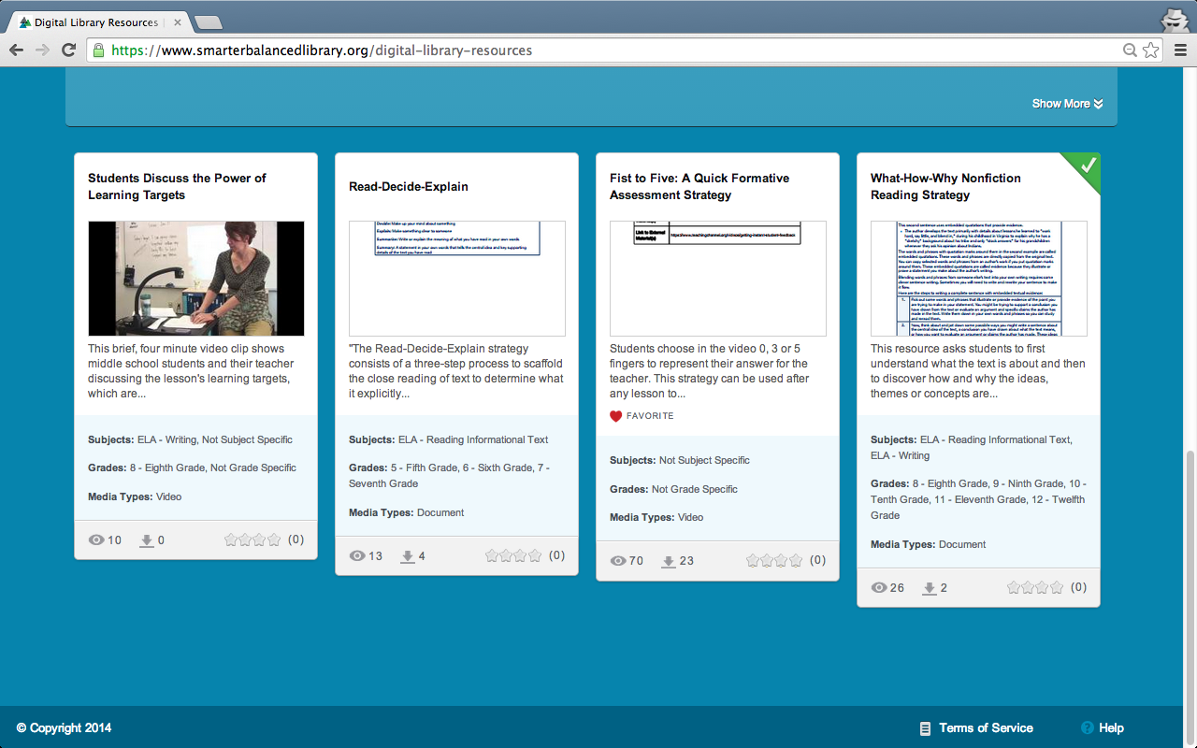
Favorites
Notes:
The first step in making a resource a favorite is to open it up.
Recall that you find resources when you are in the Digital Library Resource tab.
Open a resource by clicking on the title in the card or list view.

Slide 21
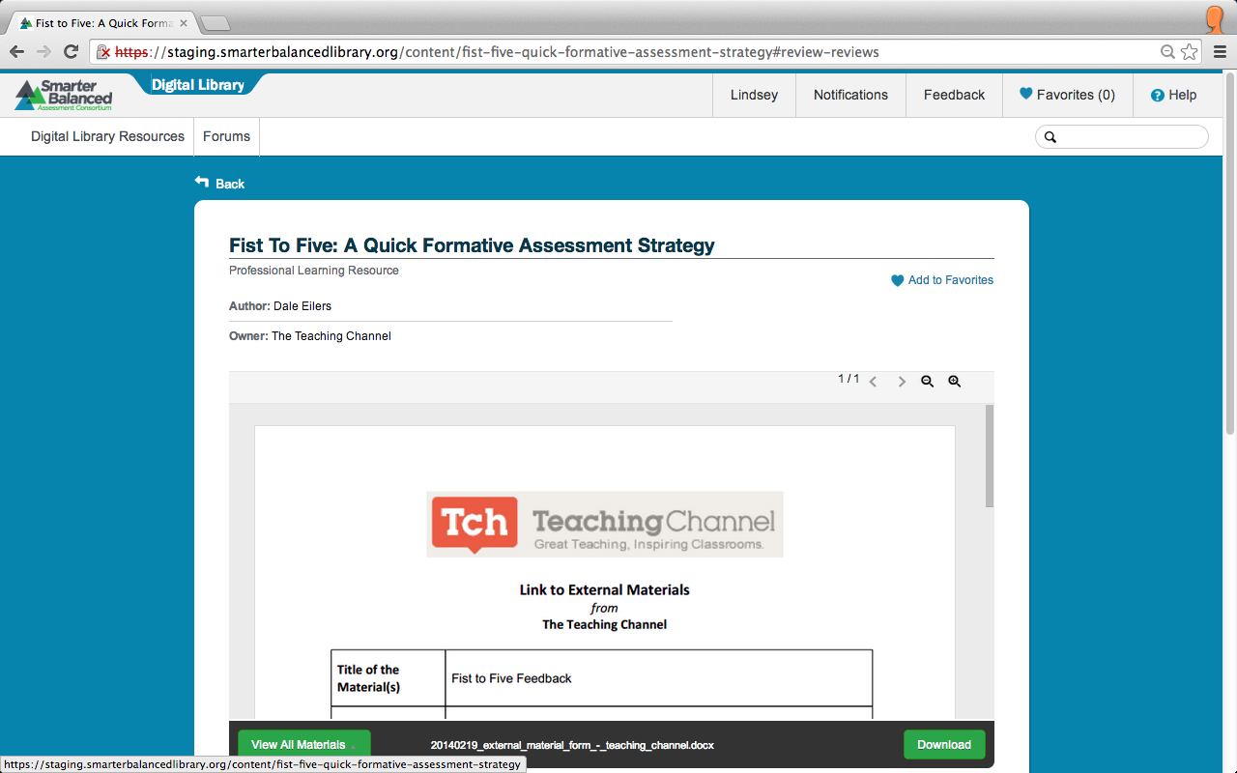
Favorites
Notes:
After clicking on a resource, you are taken to the resource page.
At the top of this page you will find the resource title, resource type, author, and owner.
To the right of this information is a heart followed by Add to Favorites.
Click this to add the resource to your Favorites list.

Slide 22
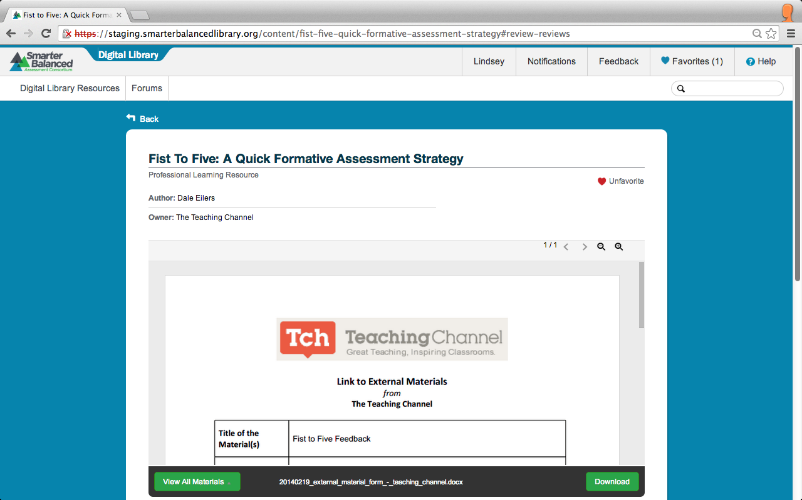

Favorites
Notes:
Once clicked, the Heart turns from gray to red. Click it again to un-favorite the resource, or remove it from your Favorites list.
Check to confirm that your resource was added to your Favorites list in the top right corner of the Digital Library. If successful, the number on the Favorites bar will increase and there will be a drop-down that says, “Added to Favorites.”

Slide 23
Favorites
Notes:
After you have marked a resource as Favorite, a heart icon and the word “FAVORITE” will also be displayed on the resource card under the summary in the Digital Library Resources.

Slide 24
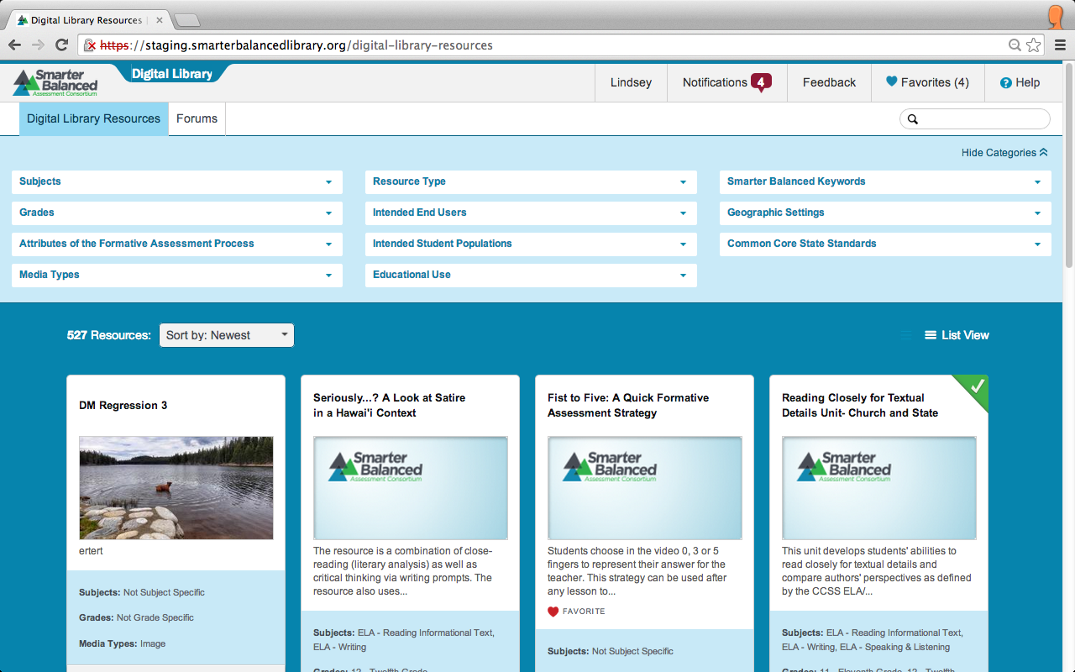
Favorites
Notes:
The number next to the word Favorites, in the top right corner of the Digital Library, indicates how many favorites you have on your list.
To access your Favorites list click on the Favorites bar.

Slide 25
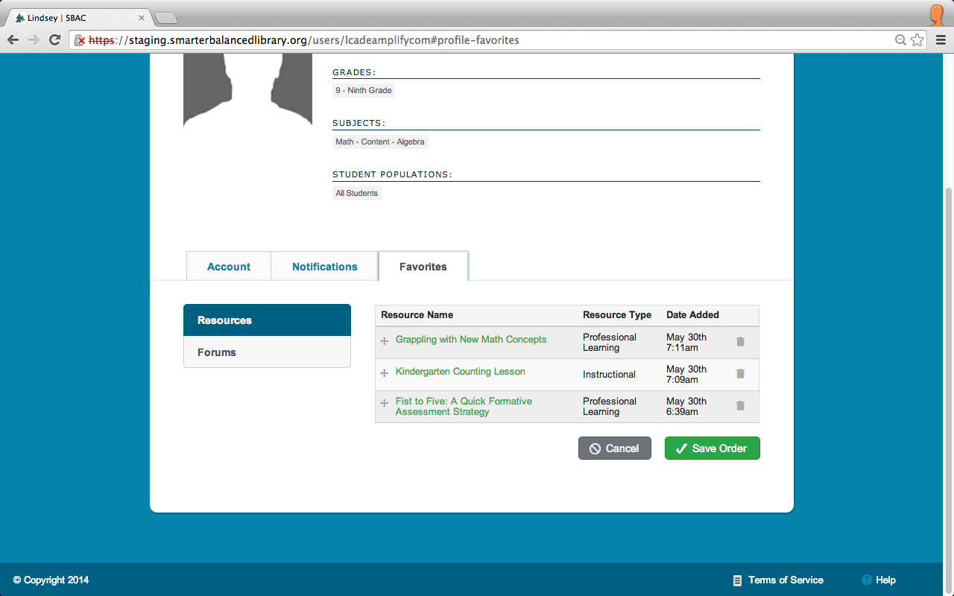
Favorites
Notes:
Clicking on the Favorites bar in the upper right corner will take you to the Favorites tab on your Personal Profile page. Here, you will find all of the resources you have marked as Favorite. The list includes the Resource Type and the Date Added to your Favorites list.

Slide 26
Favorites
Notes:
To change the order of your Favorites list, click and hold the arrow icon on the far left of the row. Then drag the resource to a new location on the list. Click Save Order to save a new Favorites list order.
To remove resources from your Favorites list click the trash icon on the far right of the row.

